Slide 1

DEliVERiNGSKiLLS
DRiViNGSUCCESS
www.VINSYS.COM

Slide 2
Difference Between Two-Tier And Three-Tier database architecture

Slide 3
1. Two-Tier Database Architecture – In two-tier, the application logic is either buried inside the User Interface on the client or within the database on the server (or both). With two-tier client/server architectures, the user system interface is usually located in the user’s desktop environment and the database management services are usually in a server that is a more powerful machine that services many clients.
2. Three-Tier Database Architecture – In three-tier, the application logic or process lives in the middle-tier, it is separated from the data and the user interface. Three-tier systems are more scalable, robust and flexible. In addition, they can integrate data from multiple sources. In the three-tier architecture, a middle tier was added between the user system interface client environment and the database management server environment. There are a variety of ways of implementing this middle tier, such as transaction processing monitors, message servers, or application servers.

Slide 4
Difference Between Two-Tier And Three-Tier Database Architecture
S.NO | Two-Tier Database Architecture | Three-Tier Database Architecture
1 | It is a Client-Server Architecture. | It is a Web-based application.
2 | In two-tier, the application logic is either buried inside the user interface on the client or within the database on the server (or both). | In three-tier, the application logic or process resides in the middle-tier, it is separated from the data and the user interface.
3 | Two-tier architecture consists of two layers : Client Tier and Database (Data Tier). | Three-tier architecture consists of three layers : Client Layer, Business Layer and Data Layer.
4 | It is easy to build and maintain. | It is complex to build and maintain.
5 | Two-tier architecture runs slower. | Three-tier architecture runs faster.
6 | It is less secured as client can communicate with database directly. | It is secured as client is not allowed to communicate with database directly.
7 | It results in performance loss whenever the users increase rapidly. | It results in performance loss whenever the system is run on Internet but gives more performance than two-tier architecture.
8 | Example – Contact Management System created using MS-Access or Railway Reservation System, etc. | Example – Designing registration form which contains text box, label, button or a large website on the Internet, etc.

Slide 5
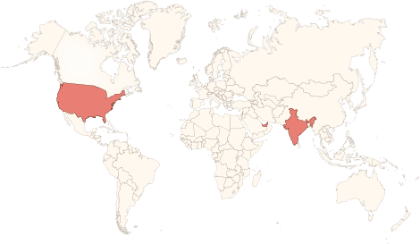

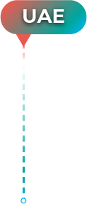
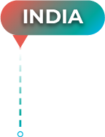



Physical Presence
www.vinsys.com
enquiry@vinsys.com
Shivaji Niketan, Tejas Society, Behind Kothrud Bus Stand, Near Mantri Park, Kothrud, Pune - 411029.
304, City Tower 2, Near Crown Plaza, Sheikh Zayed Road. Dubai, UAE.
PO.Box - 213279
132 West 31st Street, First Floor, New York, 10001, USA

